Slide 1
CSE405: Digital Signal Processing

Slide 2
Introduction Part-1

Slide 3
Lesson Outline
Introduction
Signals
Systems
Signal processing
Filters

Slide 4


Introduction
The concepts of signals and systems arise in a wide variety of areas:
Communications
Circuit design
Biomedical engineering
Power systems
Speech processing etc.

Slide 5
Signals
Basically it is a physical quantity. It is described as a function with some independent or dependent variables.
Signals can be One-dimensional or multidimensional.
• One-dimensional signals: function depends on a single variable, e.g., speech signal
• Multi-dimensional signals: function depends on two or more variables, e.g., image
Any physical phenomenon that carries or convey information from one place to other and represents as a function of independent variables such as time, distance, etc.
Signals are represented mathematically as a function of one or more independent variable.

Slide 6
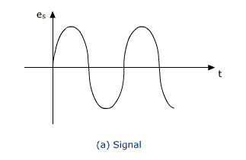
Signals
In case of one dimension, Signals involving a single independent variable, generally refer to as a time, t are considered.
Although it may not represent time in specific application
A signal is a real-valued or scalar-valued function of an independent variable t.

Slide 7
Signal Examples
Electrical signals --- voltages and currents in a circuit
Acoustic signals --- audio or speech signals (analog or digital)
Video signals --- intensity variations in an image (e.g. a CAT scan)
Biological signals --- sequence of bases in a gene
Noise: unwanted signal

Slide 8
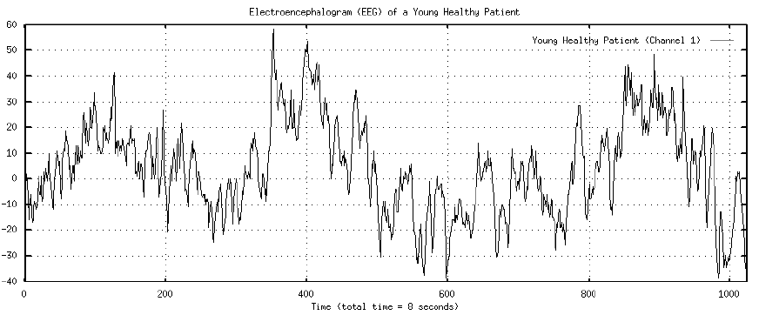
Signal Examples
Brain wave

Slide 9
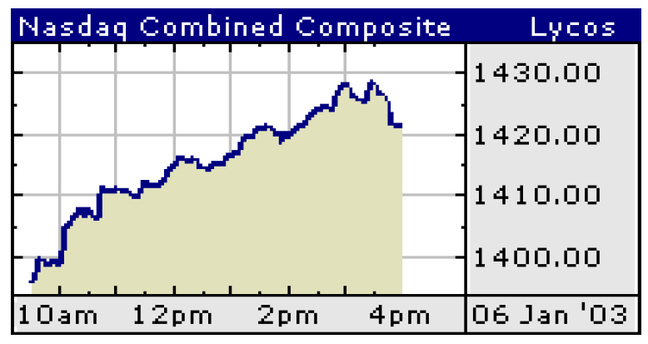
Signal Examples
Stock Market data as signal (time series)

Slide 10
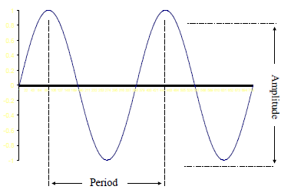
Measuring Signals

Slide 11
Definitions
Voltage – the force which moves an electrical current against resistance
Waveform – the shape of the signal (previous slide is a sine wave) derived from its amplitude and frequency over a fixed time (other waveform is the square wave)
Amplitude – the maximum value of a signal, measured from its average state
Frequency (pitch) – the number of cycles produced in a second – Hertz (Hz). Relate this to the speed of a processor e.g. 1.4GigaHertz or 1.4 billion cycles per second

Slide 12
Classification of signals
Continuous-time and discrete-time signals
Periodic and non-periodic signals
Casual and Non-casual signals
Deterministic and random signals
Even and odd signals

Slide 13
Signal Basics
Continuous time (CT) and discrete time (DT) signals
CT signals take on real or complex values as a function of an independent.
variable that ranges over the real numbers and are denoted as x(t).
DT signals take on real or complex values as a function of an independent.
variable that ranges over the integers and are denoted as x[n].
Note the subtle use of parentheses and square brackets to distinguish between CT and DT signals.

Slide 14
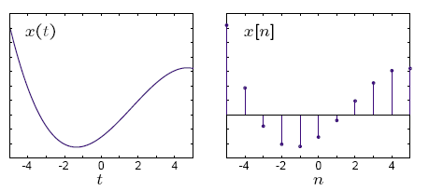
Continuous time (CT) and discrete time (DT) signals

Slide 15




Analog Signals
Human Voice – best example
Ear recognizes sounds 20KHz or less
AM Radio – 535KHz to 1605KHz
FM Radio – 88MHz to 108MHz

Slide 16
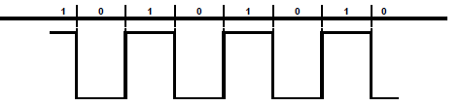
Digital signals
Represented by Square Wave
All data represented by binary values
Single Binary Digit – Bit
Transmission of contiguous group of bits is a bit stream
Not all decimal values can be represented by binary

Slide 17
Analog vs. Digital
Analog Advantages
Best suited for audio and video
Consume less bandwidth
Available world wide
Less susceptible to noise
Digital Advantages
Best for computer data
Can be easily compressed
Can be encrypted
Equipment is more common and less expensive
Can provide better clarity

Slide 18
Analog or Digital
Analog Message: continuous in amplitude and over time
– AM, FM for voice sound
– Traditional TV for analog video
– First generation cellular phone (analog mode)
– Record player
Digital message: 0 or 1, or discrete value
– VCD, DVD
– 2G/3G cellular phone
– Data on your disk
– Your grade

Slide 19
A/D and D/A
Analog to Digital conversion; Digital to Analog conversion
– Gateway from the communication device to
the channel
Nyquist Sampling theorem
– From time domain: If the highest frequency
in the signal is B Hz, the signal can be
reconstructed from its samples, taken at a rate
not less than 2B samples per second

Slide 20
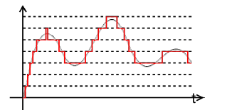
A/D and D/A
Quantization
– From amplitude domain
– N bit quantization, L intervals L=2N
– Usually 8 to 16 bits
– Error Performance: Signal to noise ratio

Slide 21

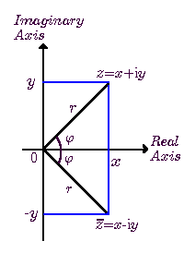
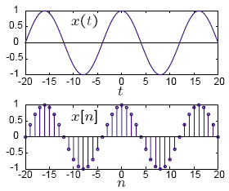
Real vs. Complex
Q. Why do we deal with complex signals?
They are often analytically simpler to deal with than real signals, especially in digital communications.

Slide 22
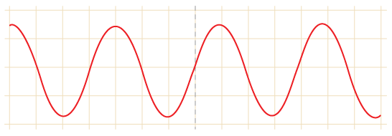
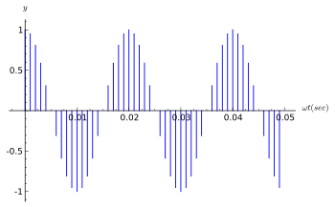
Signal processing
SIGNAL PROCESSING is the analysis, interpretation and manipulation of like sound, images, time-varying measurement values and sensor data etc.
Types of signal processing:
Analog signal processing
2. Digital signal processing

Slide 23
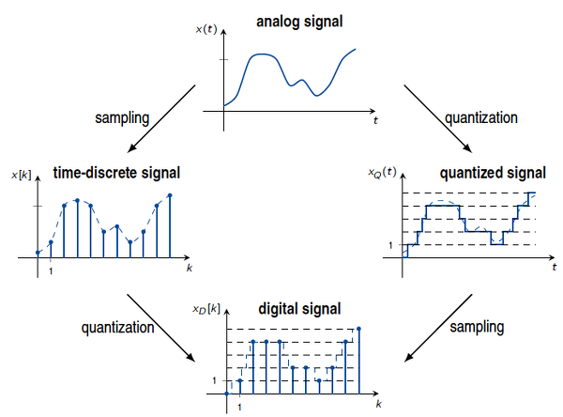

Slide 24
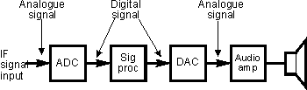
Digital Signal processing
DIGITAL: Operating by the use of discrete signal to represent data in the form of numbers.
SIGNAL: A parameter (electrical quantity or effect) that can be varied in such a way as to convey information.
PROCESSING: a series operation performed according to programmed instructions.

Slide 25
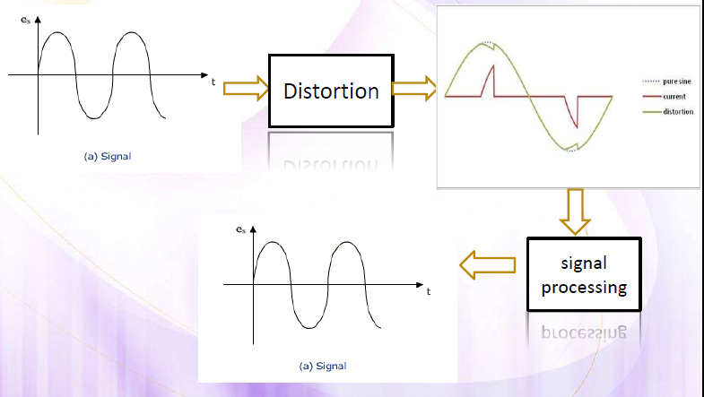
Need of Signal Processing

Slide 26
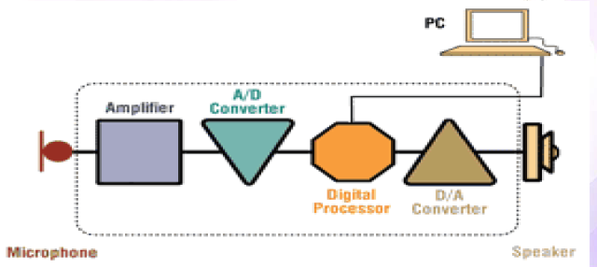
Principles and Operation
Digital signal processing consist of anti-aliasing filter ,ADC, digital processor, DAC and a reconstruction filter.

Slide 27
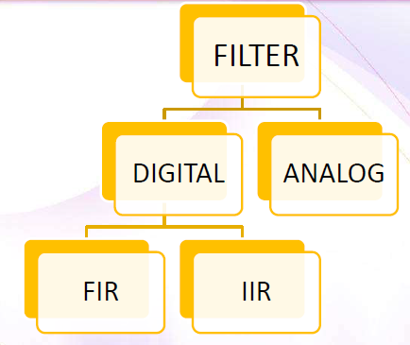
Filters
Two uses :
Signal separation
Signal Restoration
Example: an audio recording made with poor equipment may be filtered to get the original sound.

Slide 28
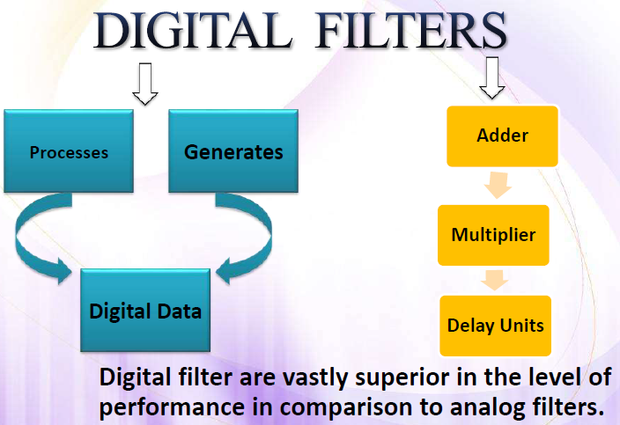

Slide 29
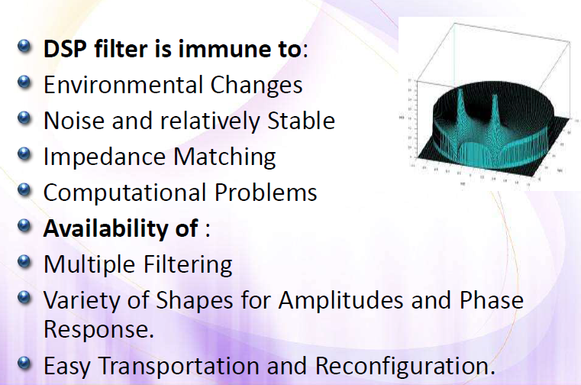
Digital Filters

Slide 30
Advantages of DSP
Accuracy
Flexibility
Easy operation
Multiplexing
Storage able

Slide 31
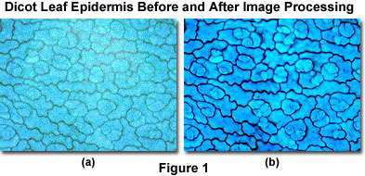


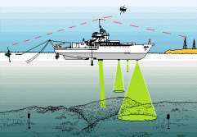

Applications of DSP
Image processing
Consumer application
Cellular mobile phones
In Communication
In Speech and Music
In Biomedical
In Radar and Sonar

